Slide 1

Fine-Grained Fake News Detection System (Group 36)
Anas Ahmad: -2020023 Anupam Narayan: - 2020030 Ayush Sharma: -2020042
Harsh Goyal: -2020562 Shivam Jindal: -2020125

Slide 2
Motivation
False or misleading information presented as news is known as fake news.
Most of the time, the goal of fake news is to hurt someone or something’s reputation or make money from advertising. Of late, fake news has been in the spotlight of mainstream journalism and the general public because it can affect a country’s political scenario.
Fake news can have a detrimental impact on society, as it can mislead people, influence their opinions and decisions, and cause harm to individuals and groups. With the rise of social media and online platforms, fake news has become increasingly prevalent and widespread.
Therefore, there is a need for a reliable and efficient fake news detection system that can help users distinguish between real and fake news.

Slide 3
Problem Statement
Our task is to determine whether a statement/speech spoken by a politician in a political rally and when published on social media/news articles as text is fake or not using NLP and associated language models.
Since, our task is a six-class classification task, therefore we are also trying to tell the user how true or how false the statement is.
Since the news statements are very short in length and the text from the speech is noisy and contains grammatical errors, the task becomes more complex and exciting.
We aim to design novel and hybrid models using pre-trained large language models to integrate the original news statement/speech with the metadata.

Slide 4
Related Work
Liar, Liar Pants on Fire - The author proposed hybrid CNN frameworks for integrating text and metadata. It consists of two CNN models with word embeddings of the given text statements as input to first CNN and the metadata as input to the other CNN. The output is then concatenated and passed through a dense layer.
A Retrospective Analysis of the Fake News Challenge Stance Detection Task - The paper proposed solution to four classes classification task. The paper proposed a solution which contains two stacked LSTMs with 50-dimensional GloVe word embeddings as input and a three-layered neural network with 600 neurons each. The output from a three-layered neural network is fed into the output layer consisting of four neurons.

Slide 5
Related Work
On the Benefit of Combining Neural, Statistical and External Features for Fake News Identification - The author proposed how using three different word embeddings in parallel and concatenating them can benefit fake news detection. The author combined neural embeddings, statistical features, and external features to a similar type of model (with a little difference in activation functions) in parallel and concatenated them to get the combined features.
State of the Art (Accuracy) –
LIAR dataset - 0.274 on test data
LIAR plus dataset - 0.374 on test data

Slide 6
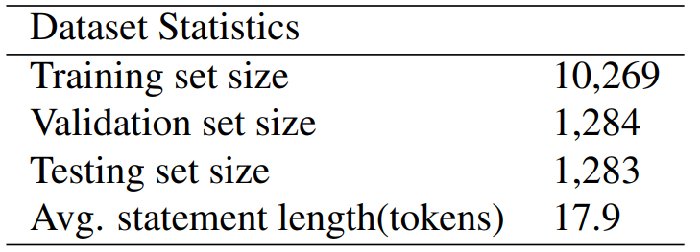
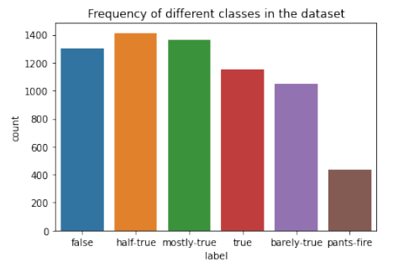
Dataset details
6 classes:
True
Mostly True
Half True
Barely True
False
Pants-Fire

Slide 7
Methodology and Models
Baseline Models - We computed TFIDF (compute TFIDF matrix for the given text data) and CountVectorizer (makes the raw count matrix for the given text data) methods to convert textual data to numerical data and fed the numerical data to various machine learning models like Logistic Regression, SVMs, Decision Trees, Random Forests, etc.
Mid-Review Evaluation Models - We computed POS taggings for the given text data. We computed TFIDF on the POS taggings to convert textual data to numerical data and fed this data to various machine learning models like Logistic Regression, Multi Layer Perceptron, etc. We computed non-contextual word embeddings using GloVe embeddings which converts textual data to 100 dimensional vector. We also computed contextual embeddings using sentence transformer model all-MiniLM-L6-v2 which converts textual data to 384 dimensional vector for each token based on the context of the sentence. We gave non-contextual and contextual word embeddings as input to various machine learning models.

Slide 8
Methodology and Models
RNNs - We first tokenize the statements using the BERT tokenizer, and trains an RNN-based BERT model to predict the labels. The model consists of a BERT layer followed by an RNN layer The RNN part of the code is responsible for processing the output of the BERT layer and producing a final output for the model. Specifically, the RNN layer used in this code is a Bidirectional LSTM (Long Short-Term Memory) layer. The model is trained for 3 epochs using a batch size of 32, and the test accuracy is reported at the end.
CNN / LSTM / Bi-LSTM - For all these models, we created POS encodings for the preprocessed data. We passed the textual data and POS encodings to Embedding() layer to get the embeddings and passed these embeddings as input to the these models. We used categorical_crossentropy as loss function. We ran these models using two approaches - only giving embeddings of statement as input and giving embeddings of text as well as POS encodings as input to these models.
Pre-trained models (BERT, RoBERTa, XLNet) - For these 3 models, we first preprocessed the data by inbuilt tokenizer of all these individual models to convert textual data to numbers. We then made the dataloader for each train, test and validate set. We trained the model and calculated the training loss and then evaluated it on validation set and testing set.

Slide 9
Results
Models | Macro F1-Scores | Accuracy
CV + LR | 0.22 | 0.25
TF-IDF + SVM | 0.22 | 0.26
CV + DT | 0.22 | 0.25
Other Baseline Models | 0.18-0.21 | 0.21-0.25
RNN | 0.26 | 0.26
LSTM (statements) | 0.20 | 0.22
LSTM (statements + POS) | 0.21 | 0.22
BiLSTM (statements) | 0.21 | 0.25
BiLSTM (statements + POS) | 0.21 | 0.22

Slide 10
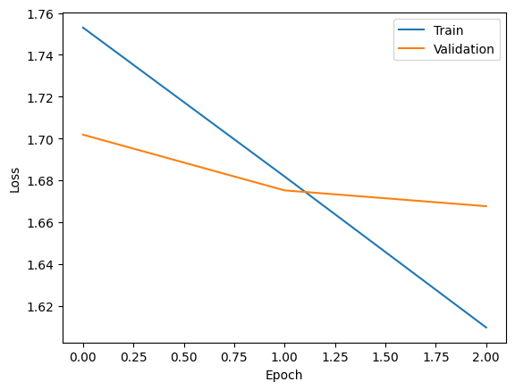
Results
Models | Macro F1-Scores | Accuracy
CNN (statements | 0.21 | 0.23
CNN (statements + POS) | 0.17 | 0.23
Bert | 0.278 | 0.283
XLNet | 0.279 | 0.289
Roberta | 0.286 | 0.292
Loss Function for XLNet model

Slide 11
Result Analysis and Novelty
The highest-performing model is the pre-trained RoBERTa model which outperformed the pre-trained BERT and XLNet models also. This might be due to the fact that RoBERTa uses dynamic masking in each epoch while BERT uses static masking and XLNet is an auto-regressive model where all tokens are predicted in random order (permutation language modelling) and hence, RoBERTa is generalized better.
We beat State of the Art accuracy (0.274) using pre-trained RoBERTa (0.292) (We merged validation data into the training data) but still there is more scope of improvement.
From novelty perspective, we used some pretrained models like BERT, RoBERTa, and XLNet. We also implemented hybrid CNN, LSTM and BiLSTM models with two different approaches of input - text data and text data + their POS taggings.

Slide 12
Conclusion
The Fine-Grained Fake News Detection System is a tool for identifying fake news articles for political statements. Its combination of machine learning algorithms and NLP techniques that allows it to analyze the content of news articles and identify features that are indicative of fake news. With so much advancement of technology, we are yet not able to solve fake news detection problem. There is still so much scope of improvement in this domain which can help prevent the spread of misinformation and ensure that news articles are accurate and reliable.

Slide 13
Contributions
Submission Phases | Work | Members
Baseline Models | - | Everyone Contributed equally
Midsem Evaluation Models | - | Everyone Contributed equally
Final Submission
 | RNN, PPT, Video | Ayush Sharma
 | BERT, RoBERTa, XLNet | Shivam Jindal
 | LSTM, PPT, Report | Anupam Narayan
 | CNNs, BiLSTMs, Report, PPT | Harsh Goyal
 | PPT, Video | Anas Ahmad

Slide 14
Thank You!

